Slide 1
A Comparison of SQL and NoSQL Databases
ISO/IEC JTC1/SC32/WG2 N1537
Keith W. Hare
JCC Consulting, Inc.
Convenor, ISO/IEC JTC1 SC32 WG3
*
Metadata Open Forum
1

Slide 2
Abstract
NoSQL databases (either no-SQL or Not Only SQL) are currently a hot topic in some parts of computing. In fact, one website lists over a hundred different NoSQL databases.
This presentation reviews the features common to the NoSQL databases and compares those features to the features and capabilities of SQL databases.
*
Metadata Open Forum
2

Slide 3
Who Am I?
Muskingum College, 1980, BS in Biology and Computer Science
Senior Consultant with JCC Consulting, Inc. since 1985 – high performance database systems
Ohio State – Masters in Computer & Information Science, 1985
SQL Standards committees since 1988
Vice Chair, INCITS H2 since 2003
Convenor, ISO/IEC JTC1 SC32 WG3 since 2005
*
Metadata Open Forum
3

Slide 4
Topics
SQL Databases
  SQL Standard
  SQL Characteristics
  SQL Database Examples
NoSQL Databases
  NoSQL Defintion
  General Characteristics
  NoSQL Database Types
  NoSQL Database Examples
*
Metadata Open Forum
4

Slide 5
Standard SQL
The following is a short, incomplete history of the SQL Standards – ISO/IEC 9075
1987 – Initial ISO/IEC Standard
1989 – Referential Integrity
1992 – SQL2
  1995 SQL/CLI (ODBC)
  1996 SQL/PSM – Procedural Language extensions
1999 – User Defined Types
2003 – SQL/XML
2008 – Expansions and corrections
2011 (or 2012) System Versioned and Application Time Period Tables
*
Metadata Open Forum
5

Slide 6
SQL Characteristics
Data stored in columns and tables
Relationships represented by data
Data Manipulation Language
Data Definition Language
Transactions
Abstraction from physical layer
*
Metadata Open Forum
6

Slide 7
SQL Physical Layer Abstraction
Applications specify what, not how
Query optimization engine
Physical layer can change without modifying applications
  Create indexes to support queries
  In Memory databases
*
Metadata Open Forum
7

Slide 8
Data Manipulation Language (DML)
Data manipulated with Select, Insert, Update, & Delete statements
  Select T1.Column1, T2.Column2 …
  From Table1, Table2 …
  Where T1.Column1 = T2.Column1 …
Data Aggregation
Compound statements
Functions and Procedures
Explicit transaction control
*
Metadata Open Forum
8

Slide 9
Data Definition Language
Schema defined at the start
Create Table (Column1 Datatype1, Column2 Datatype 2, …)
Constraints to define and enforce relationships
  Primary Key
  Foreign Key
  Etc.
Triggers to respond to Insert, Update , & Delete
Stored Modules
Alter …
Drop …
Security and Access Control
*
Metadata Open Forum
9

Slide 10
Transactions – ACID Properties
Atomic – All of the work in a transaction completes (commit) or none of it completes
Consistent – A transaction transforms the database from one consistent state to another consistent state. Consistency is defined in terms of constraints.
Isolated – The results of any changes made during a transaction are not visible until the transaction has committed.
Durable – The results of a committed transaction survive failures
*
Metadata Open Forum
10

Slide 11
SQL Database Examples
Commercial
  IBM DB2
  Oracle RDMS
  Microsoft SQL Server
  Sybase SQL Anywhere
Open Source (with commercial options)
  MySQL
  Ingres
Significant portions of the
world’s economy use SQL databases!
*
Metadata Open Forum
11

Slide 12
NoSQL Definition
From www.nosql-database.org:
  Next Generation Databases mostly addressing some of the points: being non-relational, distributed, open-source and horizontal scalable. The original intention has been modern web-scale databases. The movement began early 2009 and is growing rapidly. Often more characteristics apply as: schema-free, easy replication support, simple API, eventually consistent / BASE (not ACID), a huge data amount, and more.
*
Metadata Open Forum
12

Slide 13
NoSQL Products/Projects
http://www.nosql-database.org/ lists 122 NoSQL Databases
Cassandra
CouchDB
Hadoop & Hbase
MongoDB
StupidDB
Etc.
*
Metadata Open Forum
13

Slide 14
NoSQL Distinguishing Characteristics
Large data volumes
  Google’s “big data”
Scalable replication and distribution
  Potentially thousands of machines
  Potentially distributed around the world
Queries need to return answers quickly
Mostly query, few updates
Asynchronous Inserts & Updates
Schema-less
ACID transaction properties are not needed – BASE
CAP Theorem
Open source development
*
Metadata Open Forum
14

Slide 15
BASE Transactions
Acronym contrived to be the opposite of ACID
  Basically Available,
  Soft state,
  Eventually Consistent
Characteristics
  Weak consistency – stale data OK
  Availability first
  Best effort
  Approximate answers OK
  Aggressive (optimistic)
  Simpler and faster
*
Metadata Open Forum
15

Slide 16
Brewer’s CAP Theorem
A distributed system can support only two of the following characteristics:
Consistency
Availability
Partition tolerance
The slides from Brewer’s July 2000 talk do not define these characteristics.
*
Metadata Open Forum
16

Slide 17
Consistency
all nodes see the same data at the same time – Wikipedia
client perceives that a set of operations has occurred all at once – Pritchett
More like Atomic in ACID transaction properties
*
Metadata Open Forum
17

Slide 18
Availability
  node failures do not prevent survivors from continuing to operate – Wikipedia
Every operation must terminate in an intended response – Pritchett
*
Metadata Open Forum
18

Slide 19
Partition Tolerance
  the system continues to operate despite arbitrary message loss – Wikipedia
Operations will complete, even if individual components are unavailable – Pritchett
*
Metadata Open Forum
19

Slide 20
NoSQL Database Types
Discussing NoSQL databases is complicated because there are a variety of types:
Column Store – Each storage block contains data from only one column
Document Store – stores documents made up of tagged elements
Key-Value Store – Hash table of keys
*
Metadata Open Forum
20

Slide 21
Other Non-SQL Databases
XML Databases
Graph Databases
Codasyl Databases
Object Oriented Databases
Etc…
Will not address these today
*
Metadata Open Forum
21

Slide 22
NoSQL Example: Column Store
Each storage block contains data from only one column
Example: Hadoop/Hbase
  http://hadoop.apache.org/
  Yahoo, Facebook
Example: Ingres VectorWise
  Column Store integrated with an SQL database
  http://www.ingres.com/products/vectorwise
*
Metadata Open Forum
22

Slide 23
Column Store Comments
More efficient than row (or document) store if:
  Multiple row/record/documents are inserted at the same time so updates of column blocks can be aggregated
  Retrievals access only some of the columns in a row/record/document
*
Metadata Open Forum
23

Slide 24
NoSQL Example: Document Store
Example: CouchDB
  http://couchdb.apache.org/
  BBC
Example: MongoDB
  http://www.mongodb.org/
  Foursquare, Shutterfly
JSON – JavaScript Object Notation
*
Metadata Open Forum
24

Slide 25
CouchDB JSON Example
{
"_id": "guid goes here",
"_rev": "314159",
"type": "abstract",
"author": "Keith W. Hare"
"title": "SQL Standard and NoSQL Databases",
"body": "NoSQL databases (either no-SQL or Not Only SQL)
are currently a hot topic in some parts of
computing.",
"creation_timestamp": "2011/05/10 13:30:00 +0004"
}
*
Metadata Open Forum
25

Slide 26
CouchDB JSON Tags
"_id"
  GUID – Global Unique Identifier
  Passed in or generated by CouchDB
"_rev"
  Revision number
  Versioning mechanism
"type", "author", "title", etc.
  Arbitrary tags
  Schema-less
  Could be validated after the fact by user-written routine
*
Metadata Open Forum
26

Slide 27
NoSQL Examples: Key-Value Store
Hash tables of Keys
Values stored with Keys
Fast access to small data values
Example – Project-Voldemort
  http://www.project-voldemort.com/
  Linkedin
Example – MemCacheDB
  http://memcachedb.org/
  Backend storage is Berkeley-DB
*
Metadata Open Forum
27

Slide 28
Map Reduce
Technique for indexing and searching large data volumes
Two Phases, Map and Reduce
  Map
    Extract sets of Key-Value pairs from underlying data
    Potentially in Parallel on multiple machines
  Reduce
    Merge and sort sets of Key-Value pairs
    Results may be useful for other searches
*
Metadata Open Forum
28

Slide 29
Map Reduce
Map Reduce techniques differ across products
Implemented by application developers, not by underlying software
*
Metadata Open Forum
29

Slide 30
Map Reduce Patent
Google granted US Patent 7,650,331, January 2010
  System and method for efficient large-scale data processing
  A large-scale data processing system and method includes one or more application-independent map modules configured to read input data and to apply at least one application-specific map operation to the input data to produce intermediate data values, wherein the map operation is automatically parallelized across multiple processors in the parallel processing environment. A plurality of intermediate data structures are used to store the intermediate data values. One or more application-independent reduce modules are configured to retrieve the intermediate data values and to apply at least one application-specific reduce operation to the intermediate data values to provide output data.
*
Metadata Open Forum
30

Slide 31
Storing and Modifying Data
Syntax varies
  HTML
  Java Script
  Etc.
Asynchronous – Inserts and updates do not wait for confirmation
Versioned
Optimistic Concurrency
*
Metadata Open Forum
31

Slide 32
Retrieving Data
Syntax Varies
  No set-based query language
  Procedural program languages such as Java, C, etc.
Application specifies retrieval path
No query optimizer
Quick answer is important
May not be a single “right” answer
*
Metadata Open Forum
32

Slide 33
Open Source
Small upfront software costs
Suitable for large scale distribution on commodity hardware
*
Metadata Open Forum
33

Slide 34
NoSQL Summary
NoSQL databases reject:
  Overhead of ACID transactions
  “Complexity” of SQL
  Burden of up-front schema design
  Declarative query expression
  Yesterday’s technology
Programmer responsible for
  Step-by-step procedural language
  Navigating access path
*
Metadata Open Forum
34

Slide 35
Summary
SQL Databases
  Predefined Schema
  Standard definition and interface language
  Tight consistency
  Well defined semantics
NoSQL Database
  No predefined Schema
  Per-product definition and interface language
  Getting an answer quickly is more important than getting a correct answer
*
Metadata Open Forum
35

Slide 36
*
Metadata Open Forum
36

Slide 37
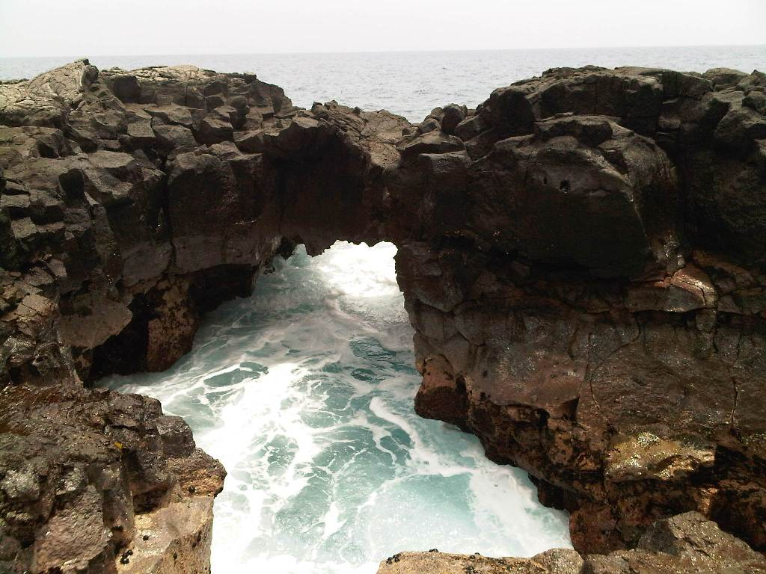
Questions?
*
Metadata Open Forum
37

Slide 38
Web References
“NoSQL -- Your Ultimate Guide to the Non - Relational Universe!”
http://nosql-database.org/links.html
“NoSQL (RDBMS)”
http://en.wikipedia.org/wiki/NoSQL
PODC Keynote, July 19, 2000. Towards Robust. Distributed Systems. Dr. Eric A. Brewer. Professor, UC Berkeley. Co-Founder & Chief Scientist, Inktomi .
www.eecs.berkeley.edu/~brewer/cs262b-2004/PODC-keynote.pdf
“Brewer's CAP Theorem” posted by Julian Browne, January 11, 2009. http://www.julianbrowne.com/article/viewer/brewers-cap-theorem
“How to write a CV” Geek & Poke Cartoon http://geekandpoke.typepad.com/geekandpoke/2011/01/nosql.html
*
Metadata Open Forum
38

Slide 39
Web References
“Exploring CouchDB: A document-oriented database for Web applications”, Joe Lennon, Software developer, Core International.
http://www.ibm.com/developerworks/opensource/library/os-couchdb/index.html
“Graph Databases, NOSQL and Neo4j” Posted by Peter Neubauer on May 12, 2010 at: http://www.infoq.com/articles/graph-nosql-neo4j
“Cassandra vs MongoDB vs CouchDB vs Redis vs Riak vs HBase comparison”, Kristóf Kovács. http://kkovacs.eu/cassandra-vs-mongodb-vs-couchdb-vs-redis
“Distinguishing Two Major Types of Column-Stores” Posted by Daniel Abadi onMarch 29, 2010 http://dbmsmusings.blogspot.com/2010/03/distinguishing-two-major-types-of_29.html
*
Metadata Open Forum
39

Slide 40
Web References
“MapReduce: Simplified Data Processing on Large Clusters”, Jeffrey Dean and Sanjay Ghemawat, December 2004.
http://labs.google.com/papers/mapreduce.html
“Scalable SQL”, ACM Queue, Michael Rys, April 19, 2011
http://queue.acm.org/detail.cfm?id=1971597
“a practical guide to noSQL”, Posted by Denise Miura on March 17, 2011 at http://blogs.marklogic.com/2011/03/17/a-practical-guide-to-nosql/
*
Metadata Open Forum
40

Slide 41
Books
“CouchDB The Definitive Guide”, J. Chris Anderson, Jan Lehnardt and Noah Slater. O’Reilly Media Inc., Sebastopool, CA, USA. 2010
“Hadoop The Definitive Guide”, Tom White. O’Reilly Media Inc., Sebastopool, CA, USA. 2011
“MongoDB The Definitive Guide”, Kristina Chodorow and Michael Dirolf. O’Reilly Media Inc., Sebastopool, CA, USA. 2010
*
Metadata Open Forum
41

